Slide 1
Results presented in the presentation has been already published in the following paper:
Kwiatek, G., K. Plenkers, P. Martínez-Garzón, M. Leonhardt, A. Zang, and G. Dresen (2017). New Insights into Fracture Process through In-Situ Acoustic Emission Monitoring During Fatigue Hydraulic Fracture Experiment in Äspö Hard Rock Laboratory, Procedia Engineering 191, 618–622, doi 10.1016/j.proeng.2017.05.225.
Please consider referring to the above paper if you find this presentation useful!

Slide 2
Insights into subdecimeter fracturing processes occuring during the hydraulic fracture experiment in Äspö HRL, Sweden
G. Kwiatek¹, P. Martínez-Garzón¹, K. Plenkers², M. Leonhardt¹, A. Zang^{1,3}, S. Specht¹, G. Dresen^{1,3}, M. Bohnhoff^{1,4}
1. Helmholtz Centre Potsdam, GFZ German Research Centre for Geosciences
2. GMuG Gesellschaft für Materialprüfung und Geophysik mbH
3. University of Potsdam, Potsdam, Germany
4. Free University Berlin, Berlin, Germany

Slide 3
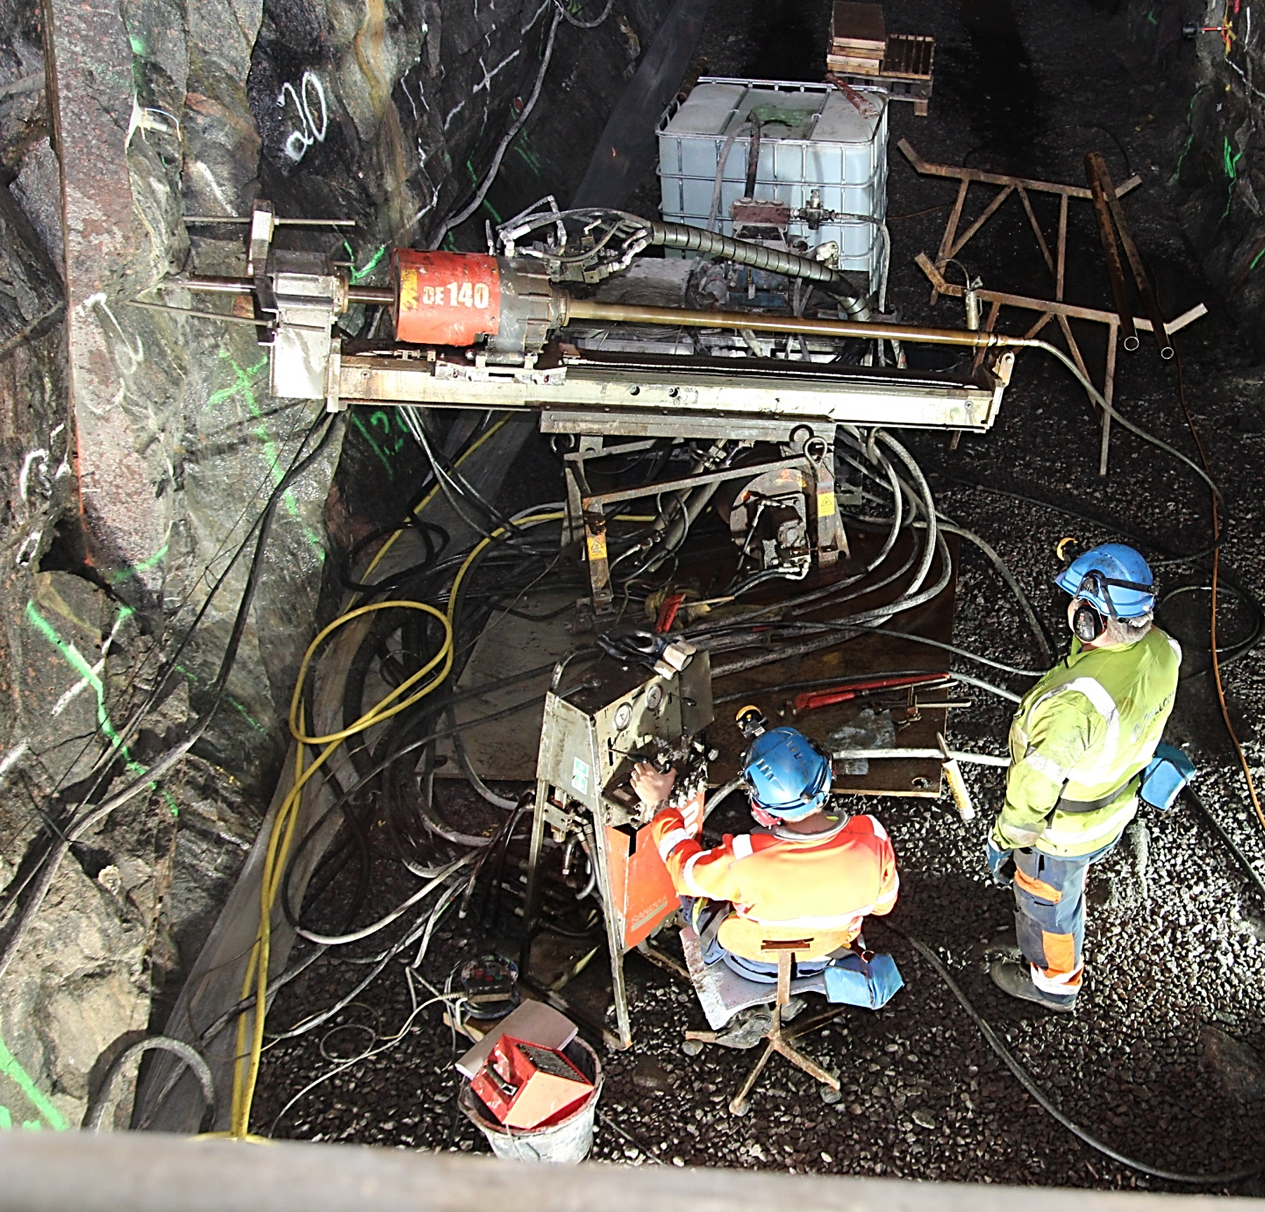



Project goals
Optimize geothermal heat exchange in crystalline rock mass by multi-stage hydraulic fracturing and minimize the induced seismicity hazard
This study
Insights into the physical microfracturing processes occurring during hydraulic stimulation through the analysis of extremely small seismic events
Notes:
The purpose of the hydraulic fracture experiment at Aspo Hard rock laboratory was to optimize the geothermal heat exchange in crystalline rocks by multi-stage hydraulic and minimize at the same time occurrence of induced seismicity.
This particular study will focus on getting insight into the physical microfracturing processes through the analysis of extremely small seismic events that occurred during the stimulation jobs.

Slide 4
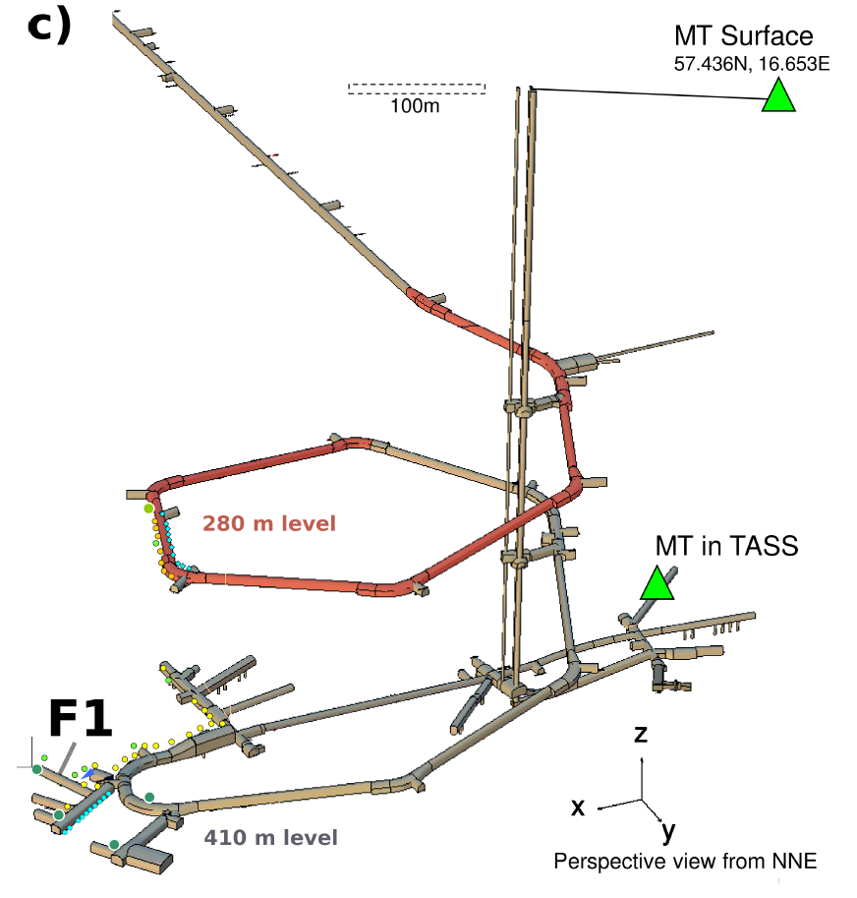
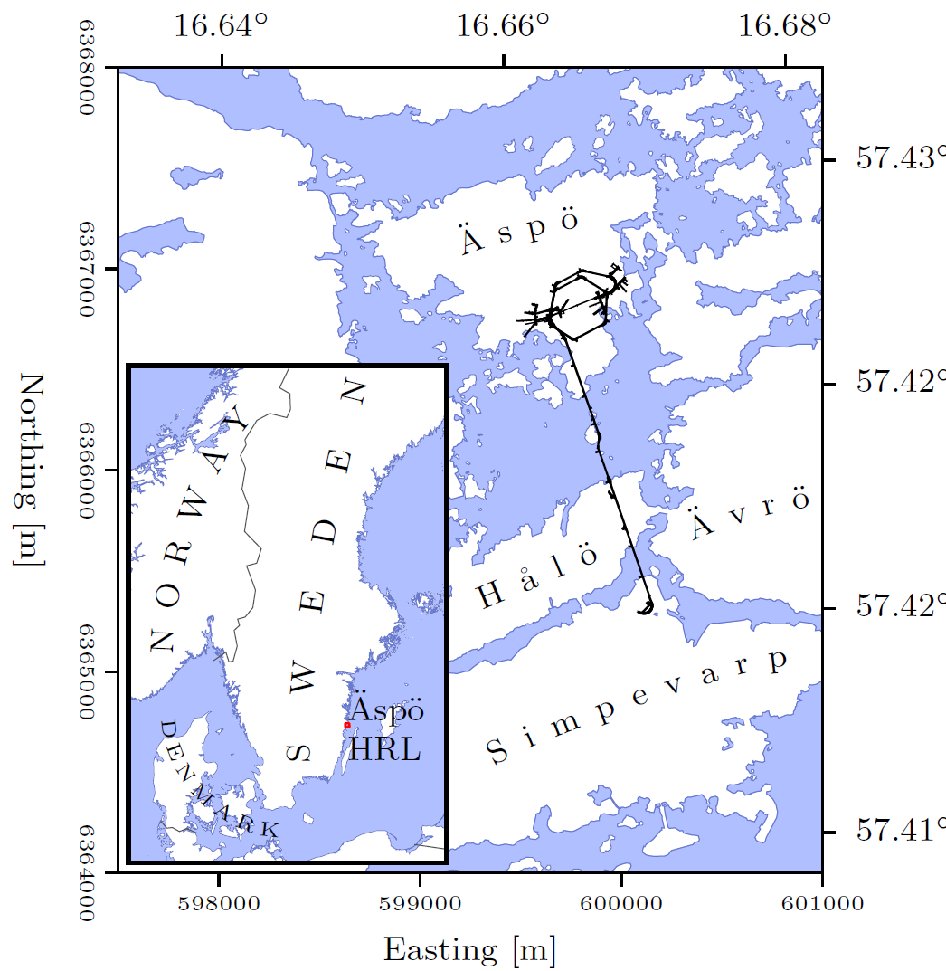
Äspö Hard Rock Laboratory
Underground test site at a depth of 410m
Rocks: Ävrö Granodiorite, fine-grained diorite-gabbro, granite
100m
Modified after: Zang et al., GJI, 2017
Notes:
The experiment was performed in an underground research laboratory located in ASPO in Sweden.
The project site was located at depth of approximately 400m located in Diorites, Diorite-Gabbro, and Granite and the total size of project area was not larger than a cube of 100m length

Slide 5
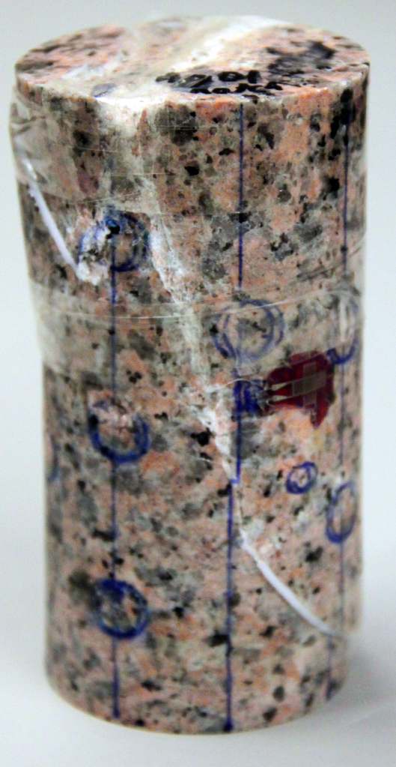
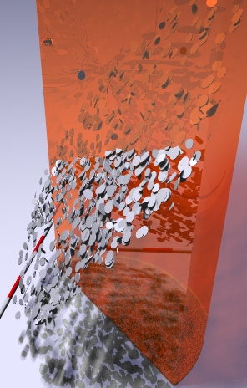
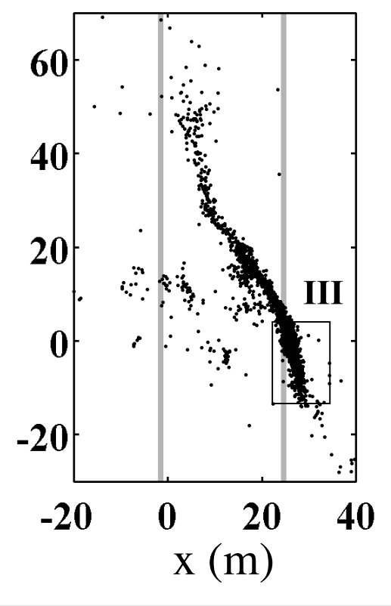
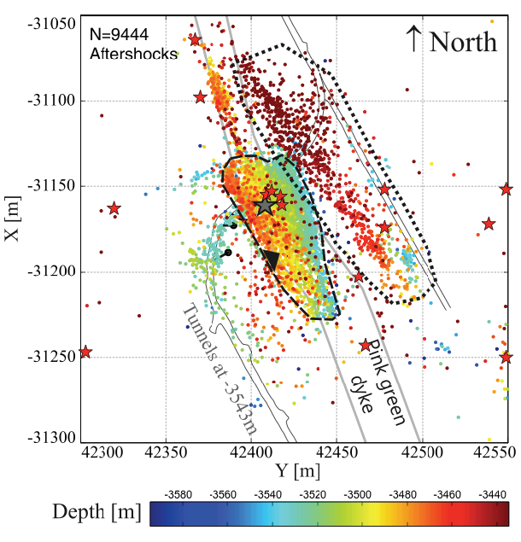
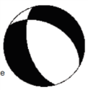
Monitoring microfractures of dm-size
10cm fault (Lab)
Fractures < 1mm
100m fault (Mponeng Mine)
Fractures < 1m
S₁
S₁
A
A’
A
A’
5cm
cf. Kwiatek et al., BSSA, 2011

Slide 6
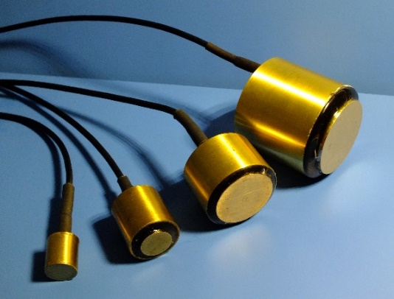
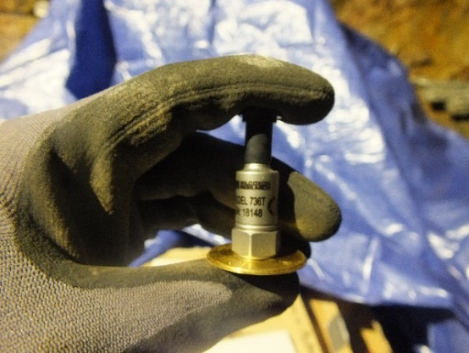
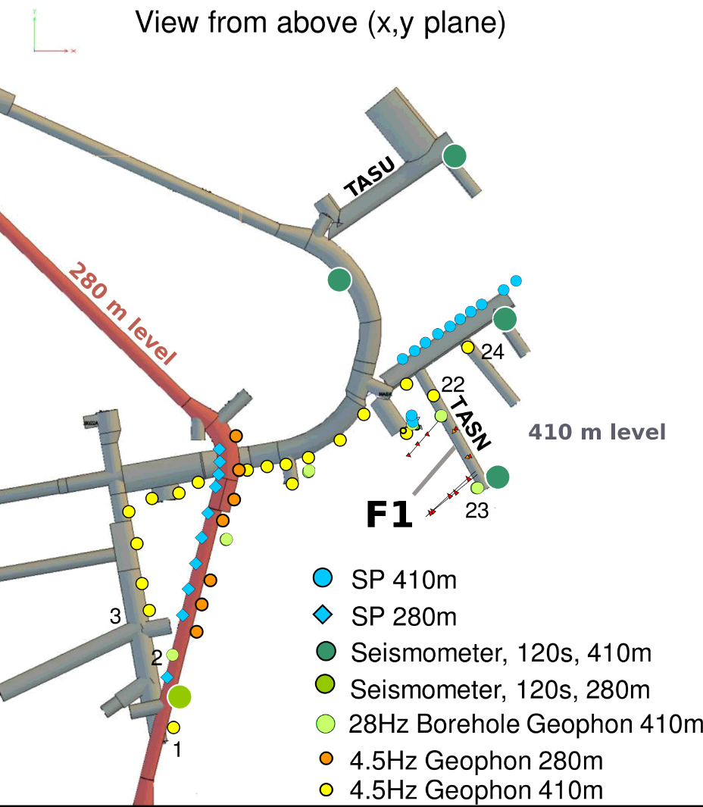
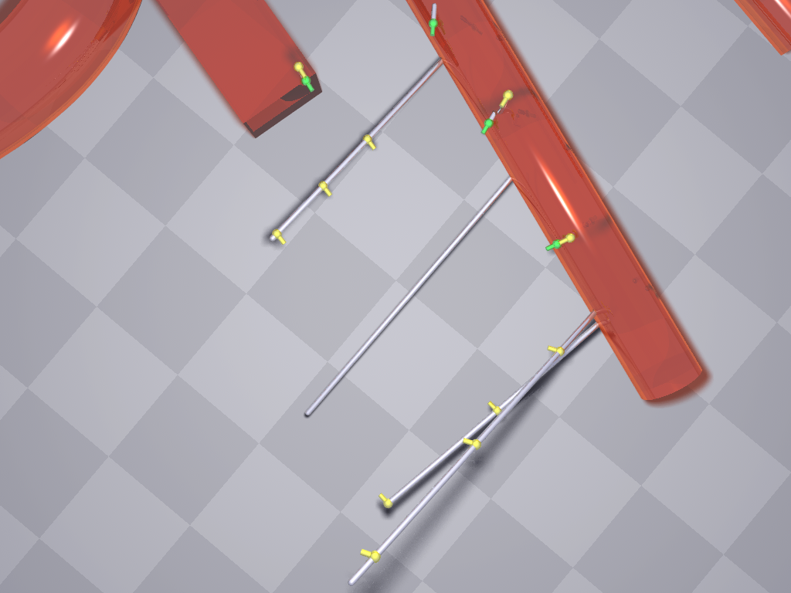
Broad range in-situ seismic monitoring
Seismic monitoring using different networks
Monitoring of fractures from km- down to cm- size
Tunnel
TASN Tunnel
AE monitoring well
Injection well
AE+Accelerometers
Self-potential
BB seismometers
Geophones
20m
AE monitoring wells
Notes:
The injection well was surrounded with different seismic networks that altogether were capable to track seismic processes down to fractures of cm length.
The microseismic networks composed of broadband seismometers and geophones were installed in tunnels surrounding the stimulation site covering the low frequency band.
For monitoring fracture development, the high frequency network was installed in boreholes and tunnels surrounding future stimulation area.

Slide 7
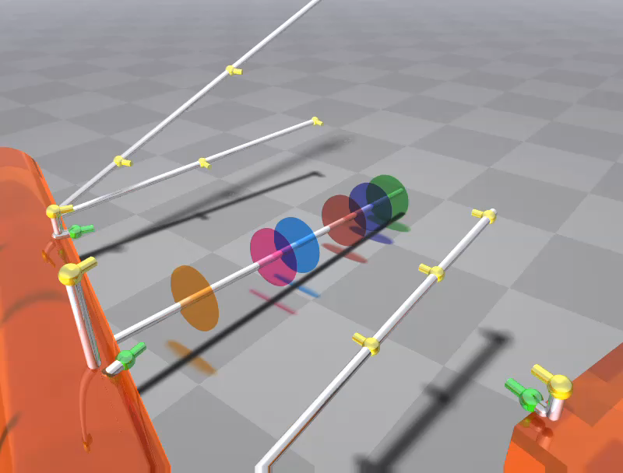
High frequency AE – Accelerometers network
11 AE sensors (1-100kHz) and 4 accelerometers (<25kHz)
Continuous/triggered acquisition at 1MHz sampling rate
Real-time tracking of fracture propagation
AE Monitoring well
Injection well
AE+Accelerometers
Self-potential
BB seismometers
Geophones
20m
AE Monitoring wells
Notes:
These high frequency network was composed of 11 AE sensors and 4 HF accelerometers.
The sensitivity of AE sensor was reaching 100kHz, which allows to record waveforms of seismic events of cm size.
The AE acquisition systems worked in countinuous and triggered modes at 1MHz sampling rate, allowing for tracking the fracture propagation in the near real-time and obtain full waveform recordings.

Slide 8
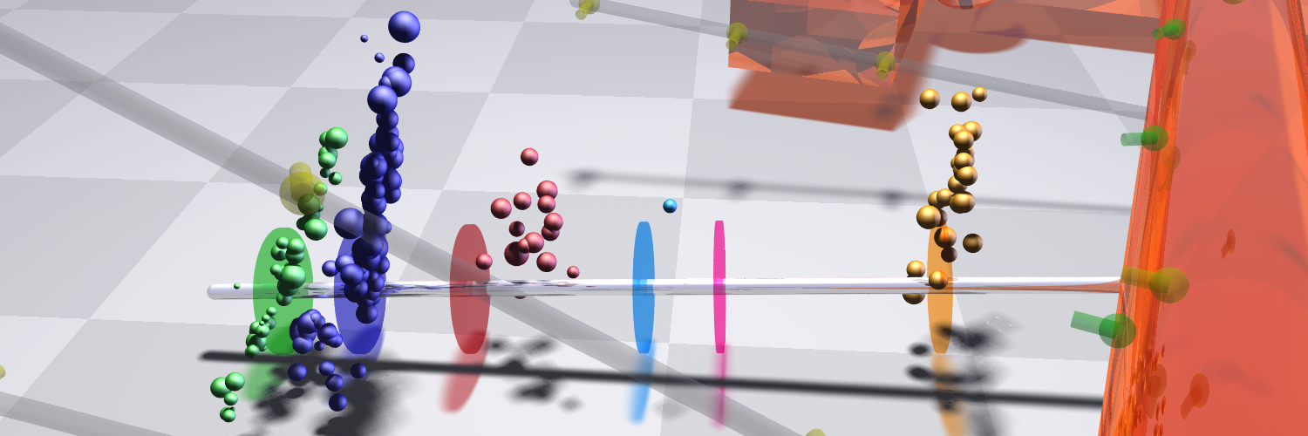
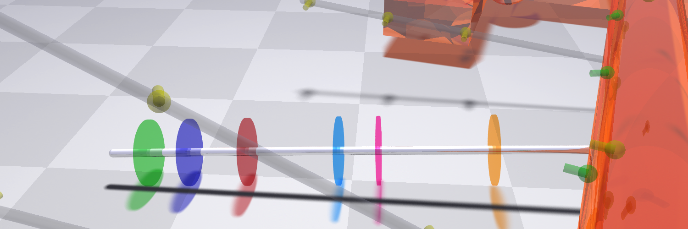
Fluid injection
28m length borehole subparallel to S_{h}
6 stimulations in 3 rock formations
Up to 5 refracs in each stimulation
3 different injection schemes
Up to 30l injected at Pinj^{max}=13MPa
HF2
continuous
HF3
progressive
HF4
continuous
HF6
continuous
HF1
continuous
TASN
Tunnel
HF5
pulse
Avro diorite
Diorite-Gabbro
Granite
HF1
continuous
HF2
continuous
HF3
progressive
HF4
continuous
HF5
pulse
HF6
continuous
Avro granodiorite
Diorite-Gabbro
Granite
Kwiatek et al., JGR, (in prep)
Notes:
The injection borehole of 28m was drilled subparallel to the minimum horizontal stress. It hosted 6 hydraulic stimulations in three different rock formations.
Each stimulation was composed of a fracturing stage, and up to 5 refracs.
Four stimulations were made using conventional, continuous injection at constant injection pressure, one using progressive, and one using pulse pressurization schemes.
Up to 30 liters of water have been injected in each stimulation, at a maximum injection pressure of 13MPa

Slide 9
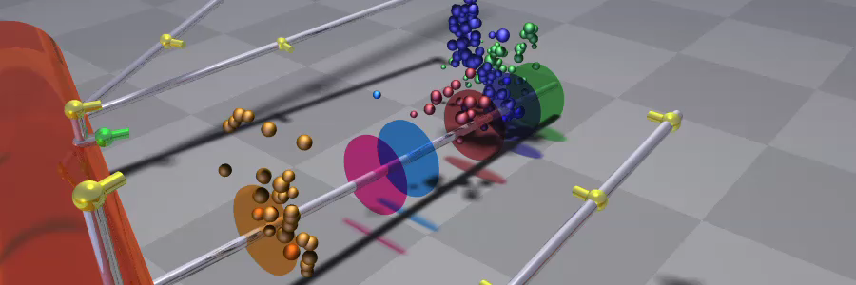
Microfracturing overview
196 AE events (M_{W} -4.2 to -3.5)
 Low S/N events: López-Comino et al. (subm.)
Activity changes with injection type and refrac number
Seismicity during stimulations and shortly after (P_{inj}>8MPa=S₃)
Quasilinear (d=1.71) upward expansion
HF1
continuous
HF2
continuous
HF3
progressive
HF4
continuous
HF5
pulse
HF6
continuous
     
     
    
   
   
   
Seismic activity during fracs and refracs:  No activity  Activity
Kwiatek et al., JGR, (in prep)
Notes:
The stimulation resulted in in a total number of 200 earthquakes with magnitudes M_{W} -4.2 to -3.5, which corresponds to fractures of 10-30cm size. More smaller events have been detected in the noise, which is a subject of a poster by Comino et al.
Seismicity occurs exclusively during and shortly after stimulations, and it seems at least 8MPa injection pressure is required to trigger the seismicity, regardless of the stimulation type, which corresponds to the magnitude of the minimum principal stress.
The activity changes with injection type and stage, however the common feature is quasi - linear (d^{boxcount}=1.71) expansion of AE activity upwards to maximum distance of ~9m

Slide 10
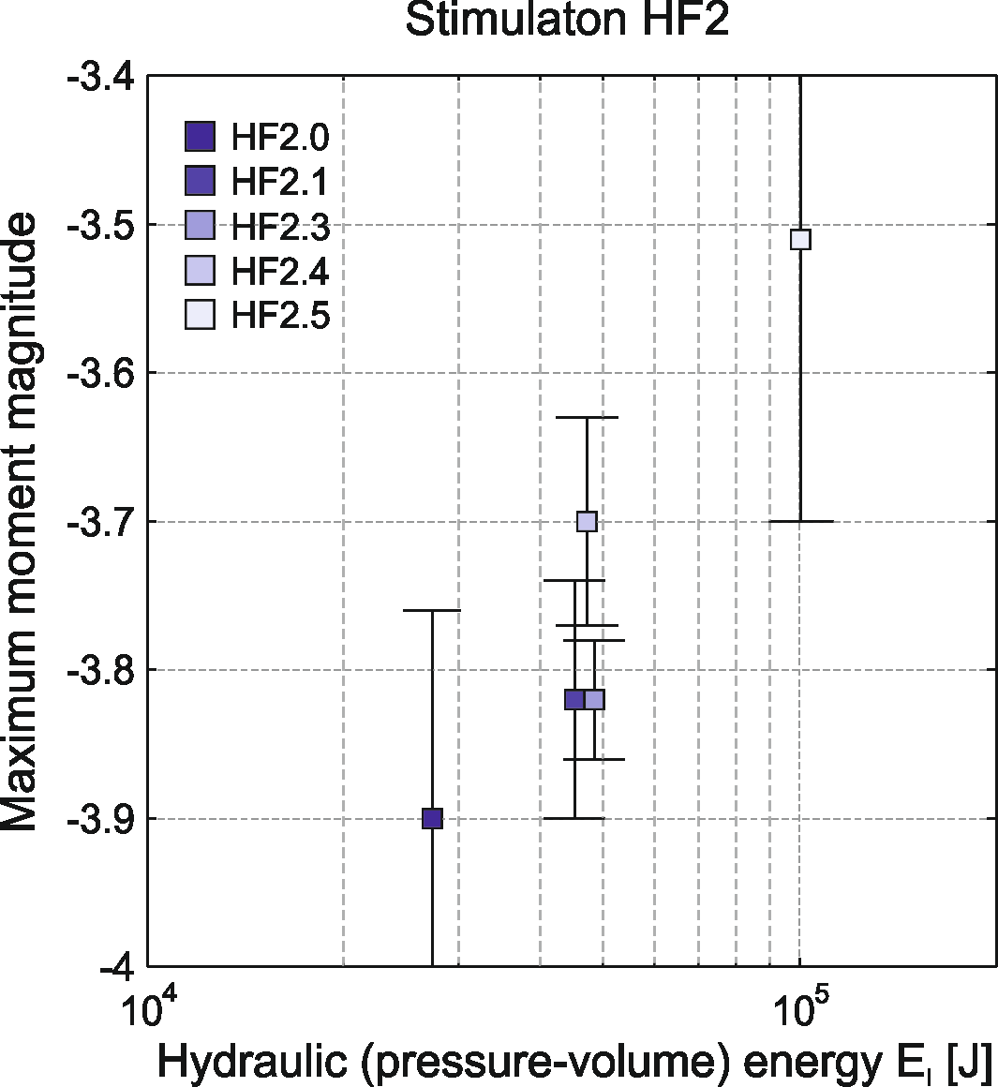
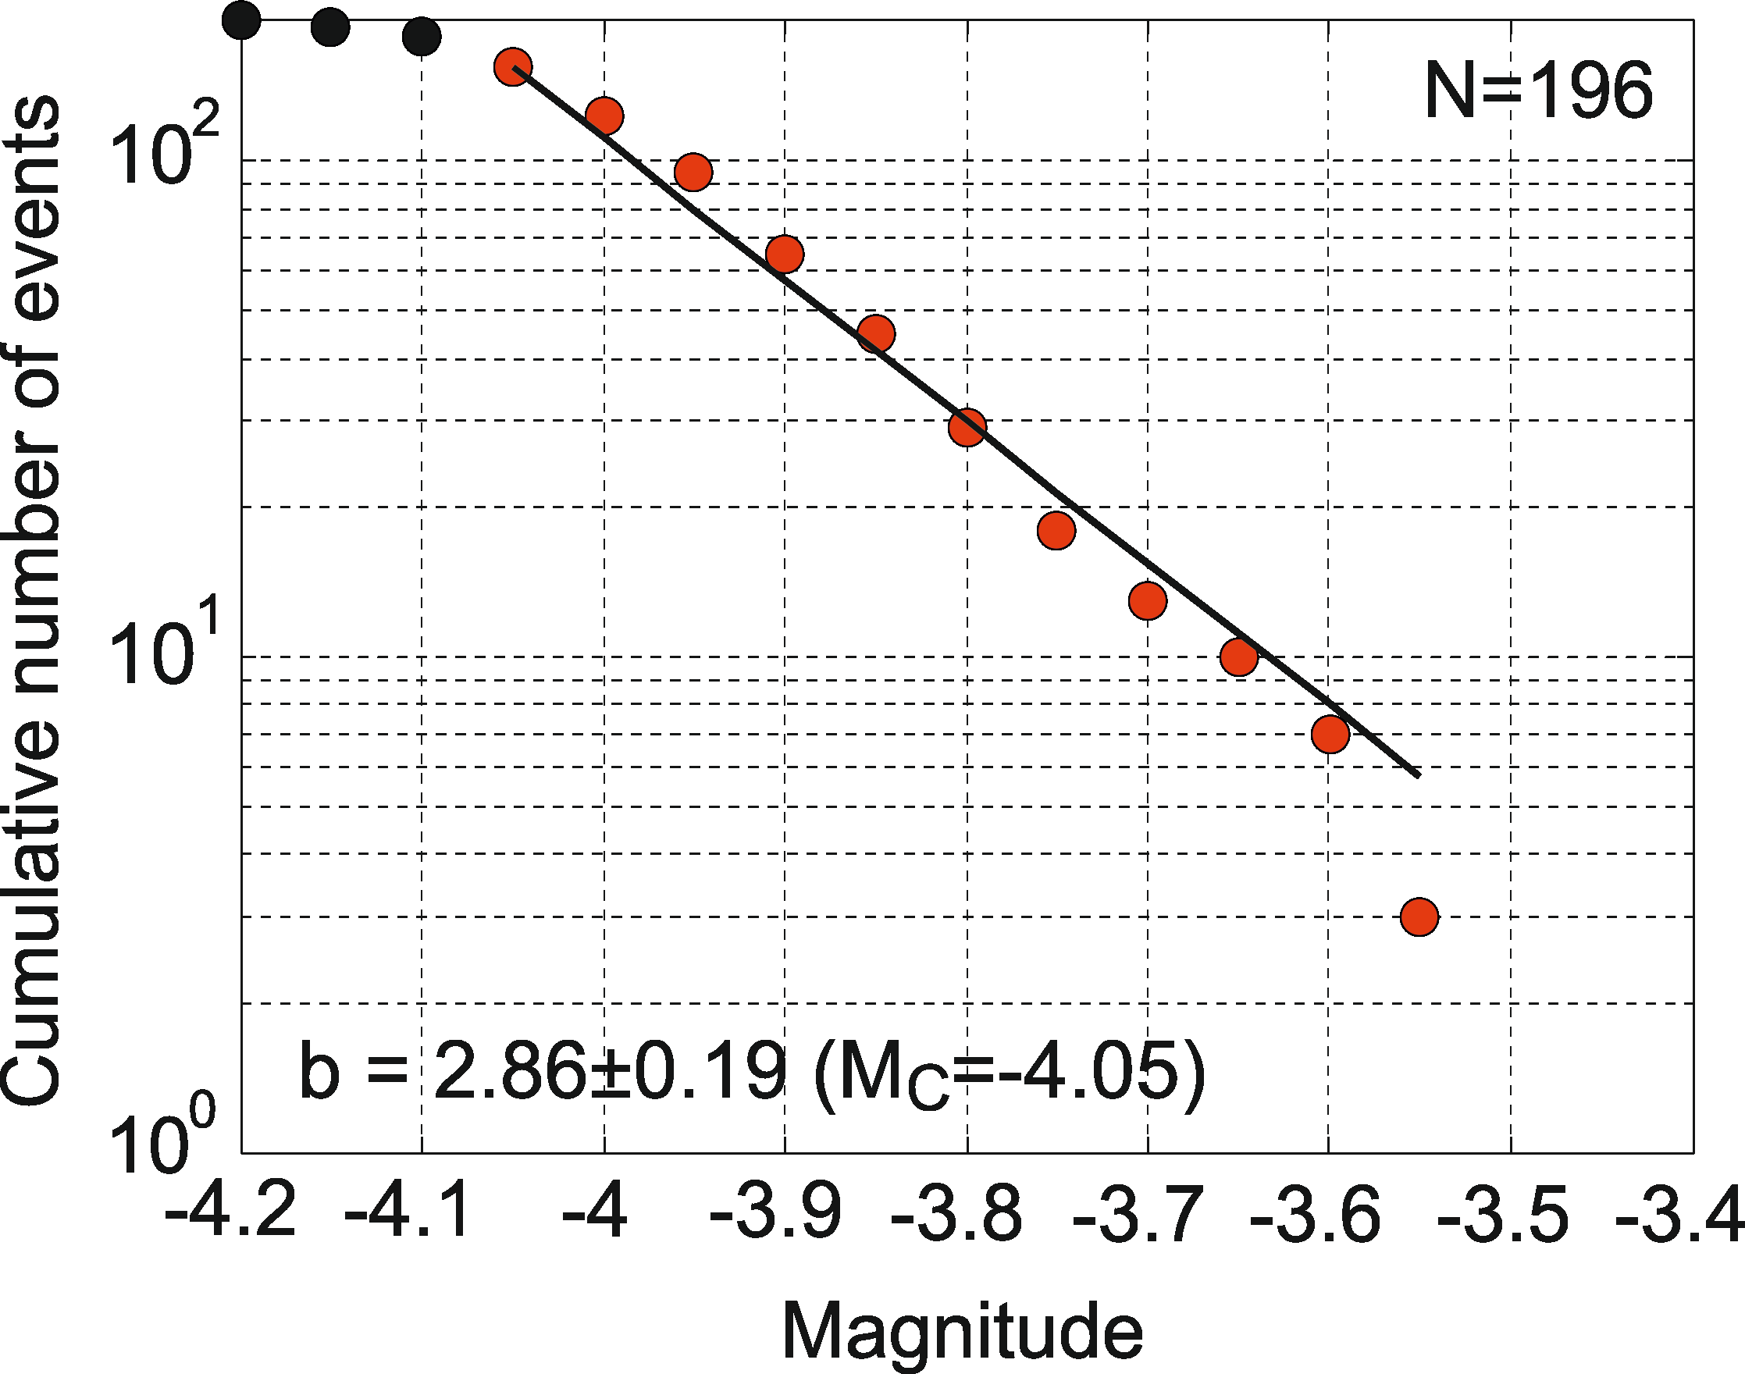
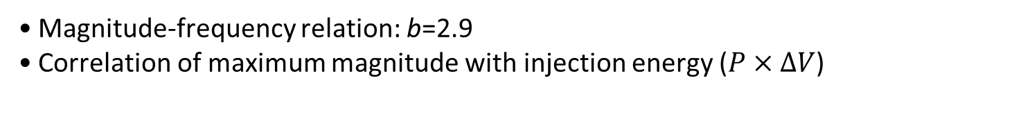
General characteristics of all AE events
Magnitude-frequency relation: b=2.9
Correlation of maximum magnitude with injection energy ($P×ΔV$)
Kwiatek et al., JGR, (in prep)
Notes:
The magnitude-frequency relation could be calculated for the whole dataset, and lead to the b-value of 1.24.
The correlation between maximum moment magnitude with injection energy here expressed as pressure times the total volume of fluid injected, is visible.
With each subsequenty refrac, the maximum magnitude increases proportionally to increase in pressur and volume injected.

Slide 11
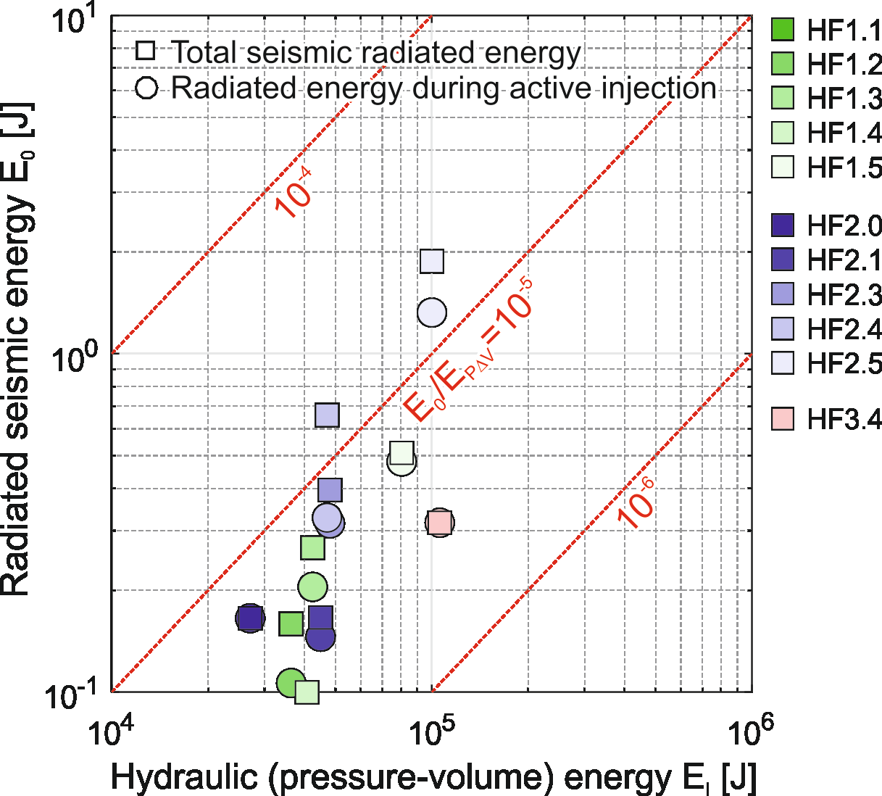
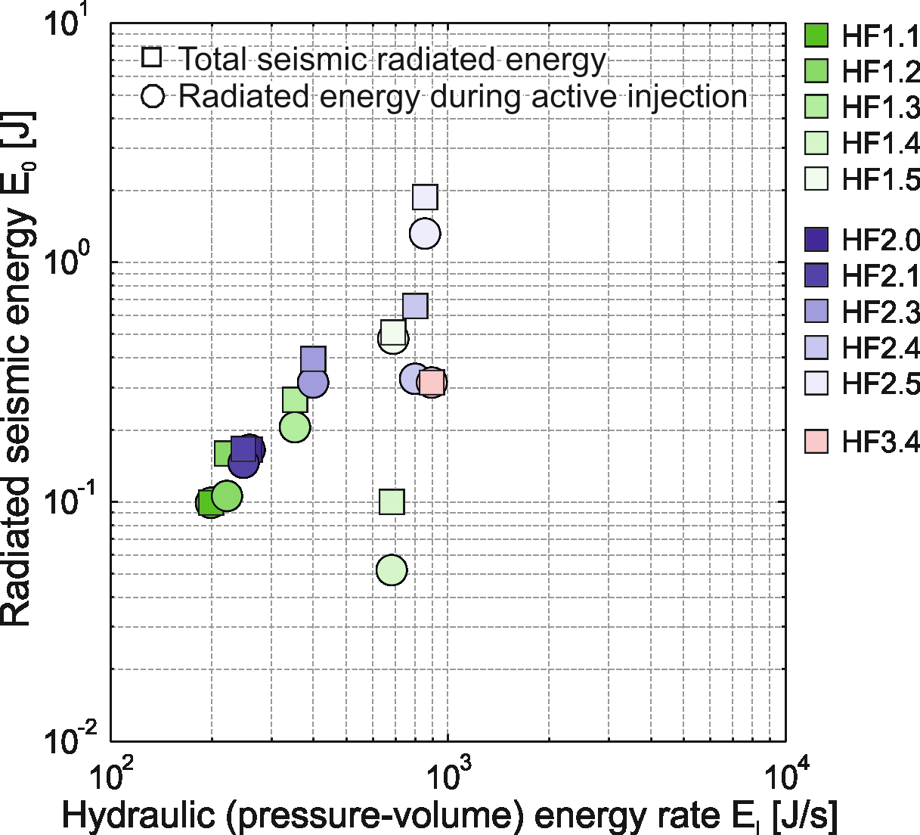

Low seismic injection efficiency
Low seismic injection efficiency $E_{rad}/E_{inj}$ of 10⁻⁵ (seismic efficiency: <0.06)
Seismic energy release correlates well with the rate of hydraulic energy
Kwiatek et al., JGR, (in prep)
Notes:
We could transfer the seismic moment to the radiated energy and investigate the relation between radiated and total injection energy.
The ratio between total radiated energy and injection energy is called injection efficiency. The ratio is very low corroborating observations of Shawn Maxwell for hydraulic fracturing. I would like to highlight, this effect not becuase of the lack of frequency band.

Slide 12
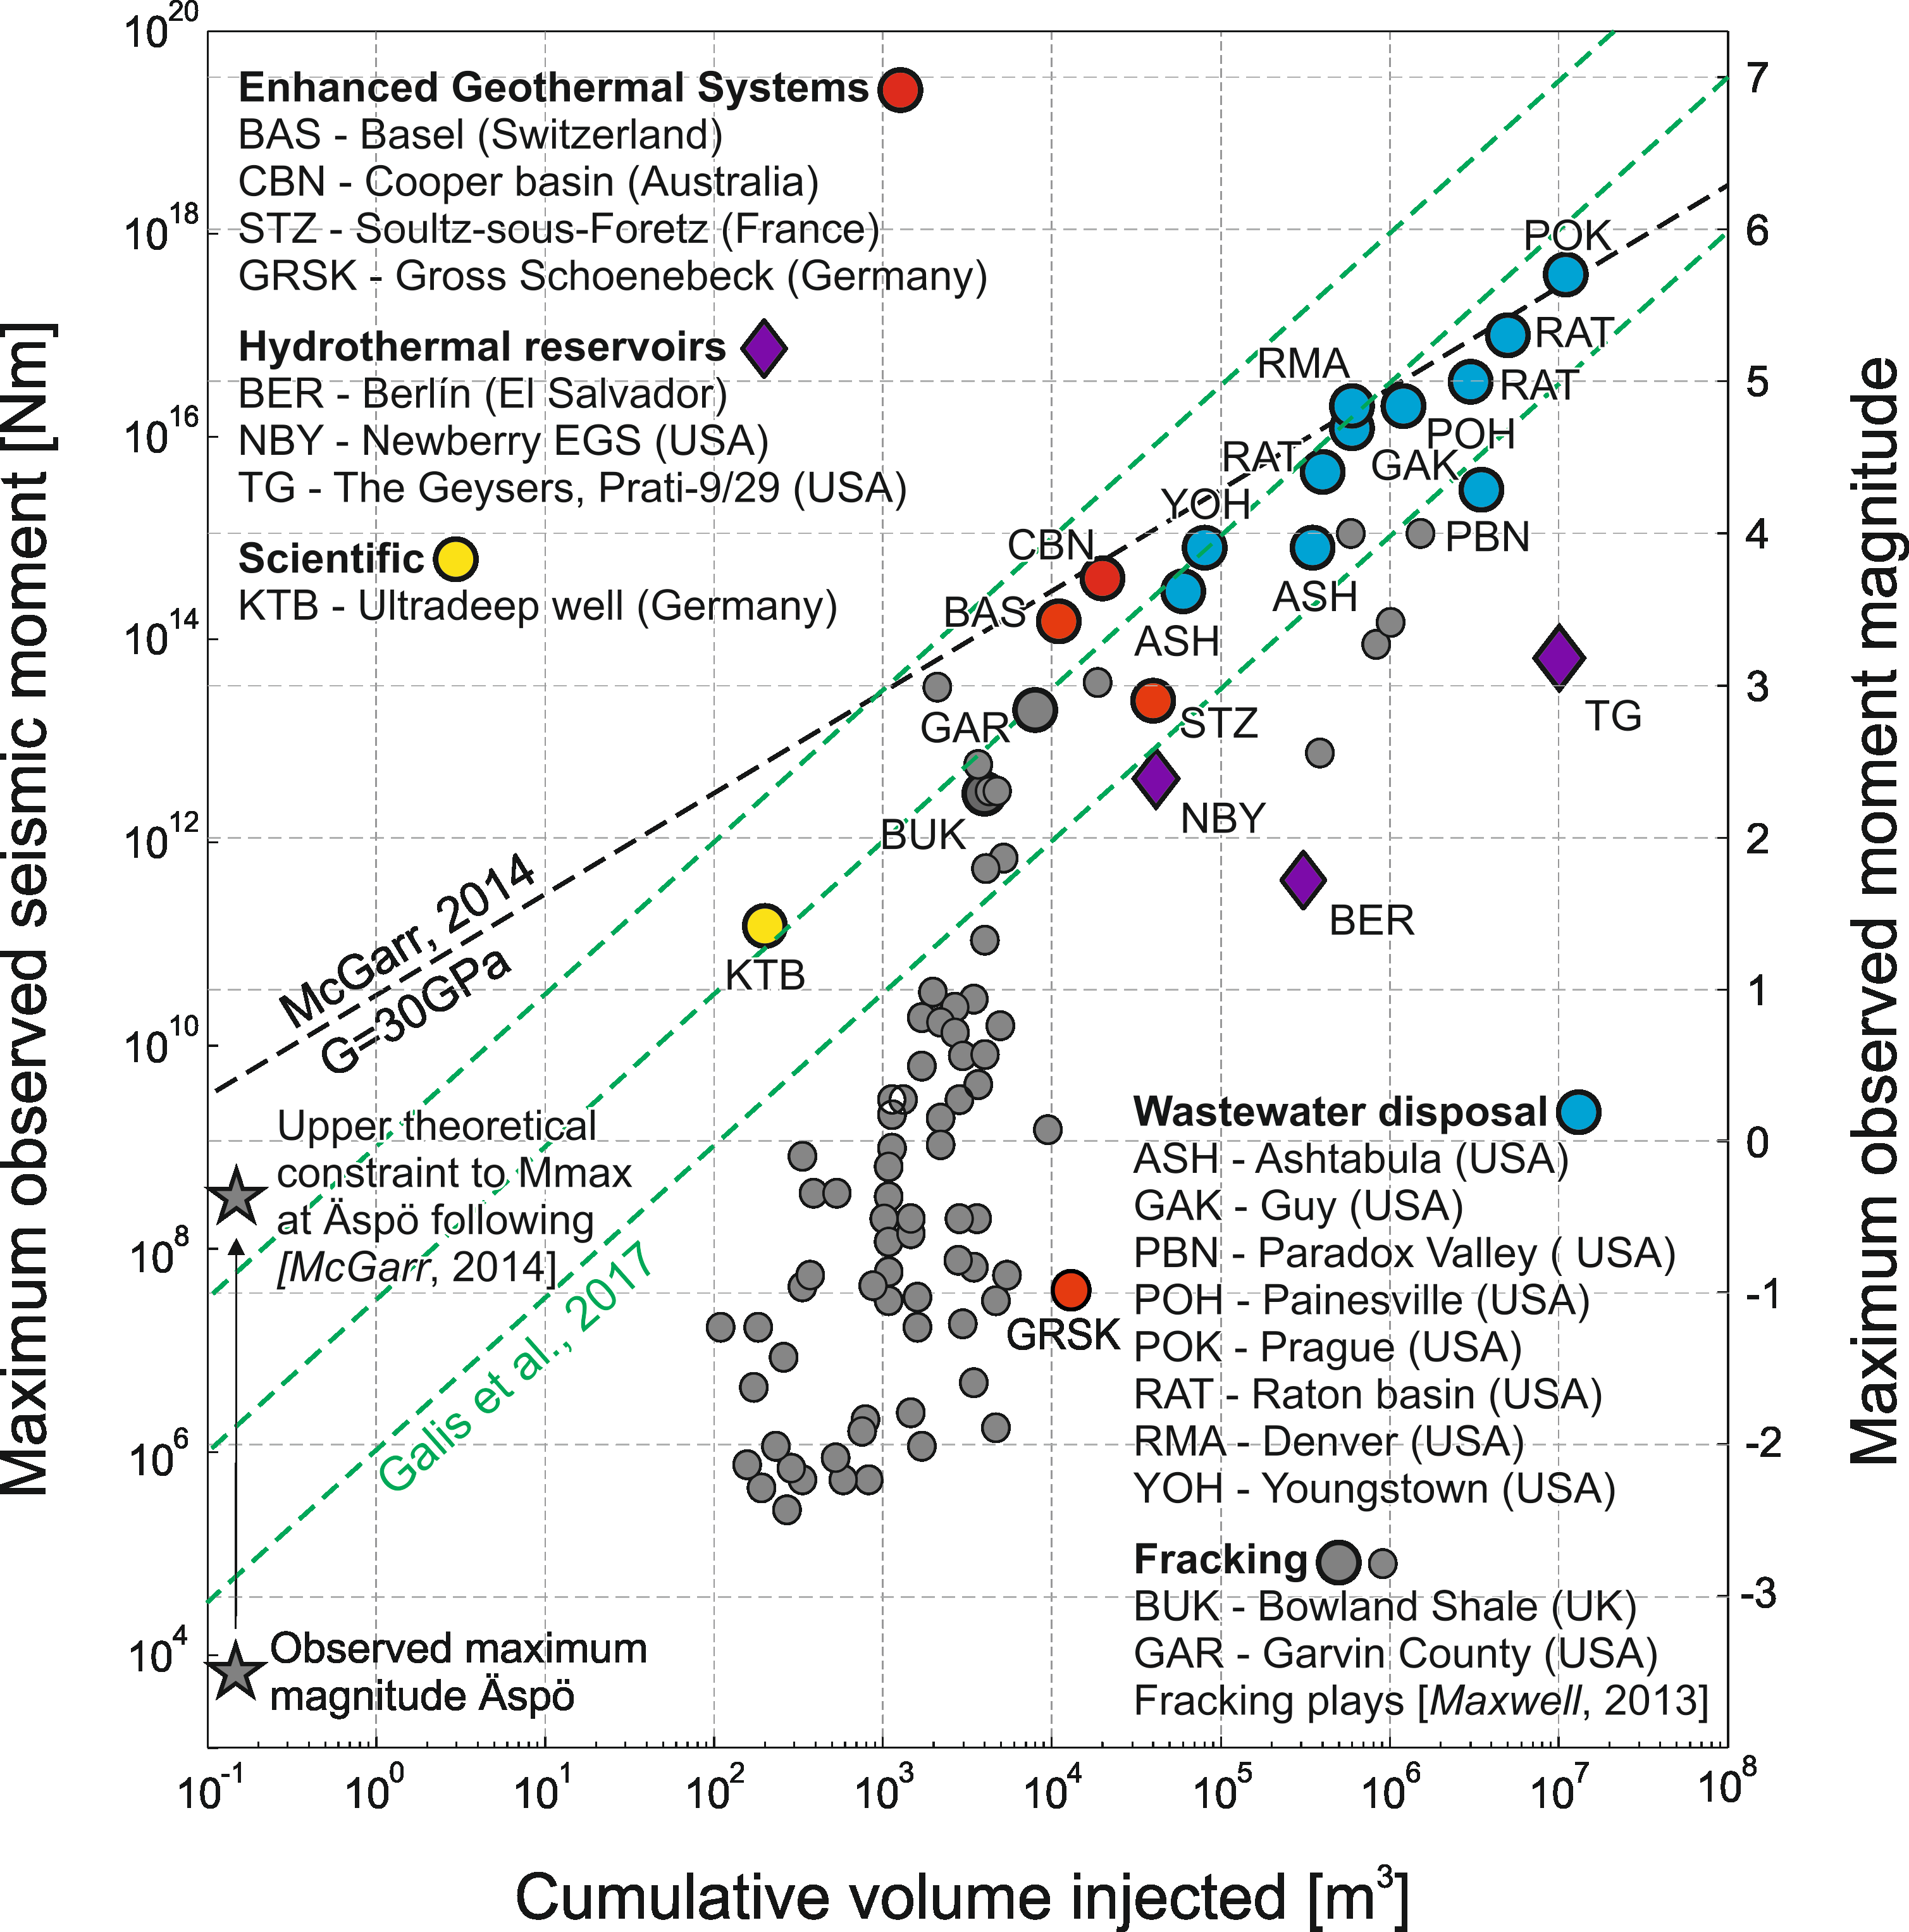
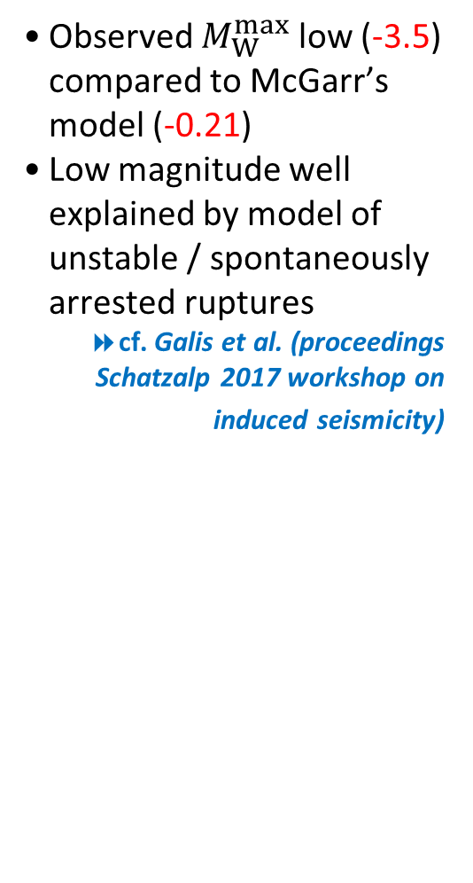
Low seismic injection energy
Observed $M_{W}^{max}$ low (-3.5) compared to McGarr’s model (-0.21)
Low magnitude well explained by model of unstable / spontaneously arrested ruptures
cf. Galis et al. (proceedings Schatzalp 2017 workshop on induced seismicity)
Kwiatek et al., JGR, (in prep)
Notes:
These observation also results in visible discrepancy between the seismic moment predicted from injecting over 100l of water following McGarr’s approach, which is -0.21 and the maximum observed magnitude equal to -3.2. This again suggest that the seismic processes we observe are of low seismic efficiency.

Slide 13
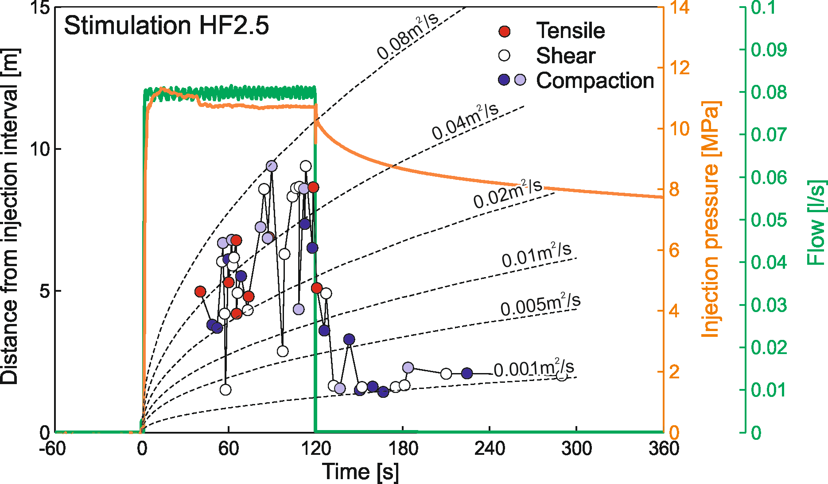
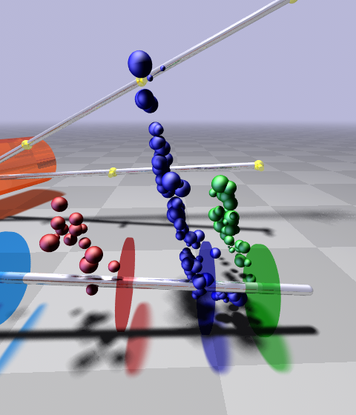
Spatio-temporal behavior
Upward propagation of AEs during injection / retreat of AEs after shut-in
Transition from shearing, crack opening, compaction (injection) to crack closing and shearing (after shut-in)
HF2
Kwiatek et al., JGR, (in prep)
Notes:
Regarding the spatiotemporal behavior, here I show an example from stage 5 of fracture 2 which consists of 50 AEs by ploting the dependence between the time and distance from injection point.
The migration of seismic events upwards from the injection point is observed during the stimulation. The migrations stops after the shut in of the well.
We could also investigate the mechanism of AE events by means of so-called polarity coefficient. This allowed us to split earthquakes into three classes – tensile, shear, and compaction events.
We found out that the injection stage is characterized by whole variety of mechanisms including fault compaction, shearing and, what is important, tensile opening. However, the shut-in phases result in events displaying pore space closing mechanism.

Slide 14
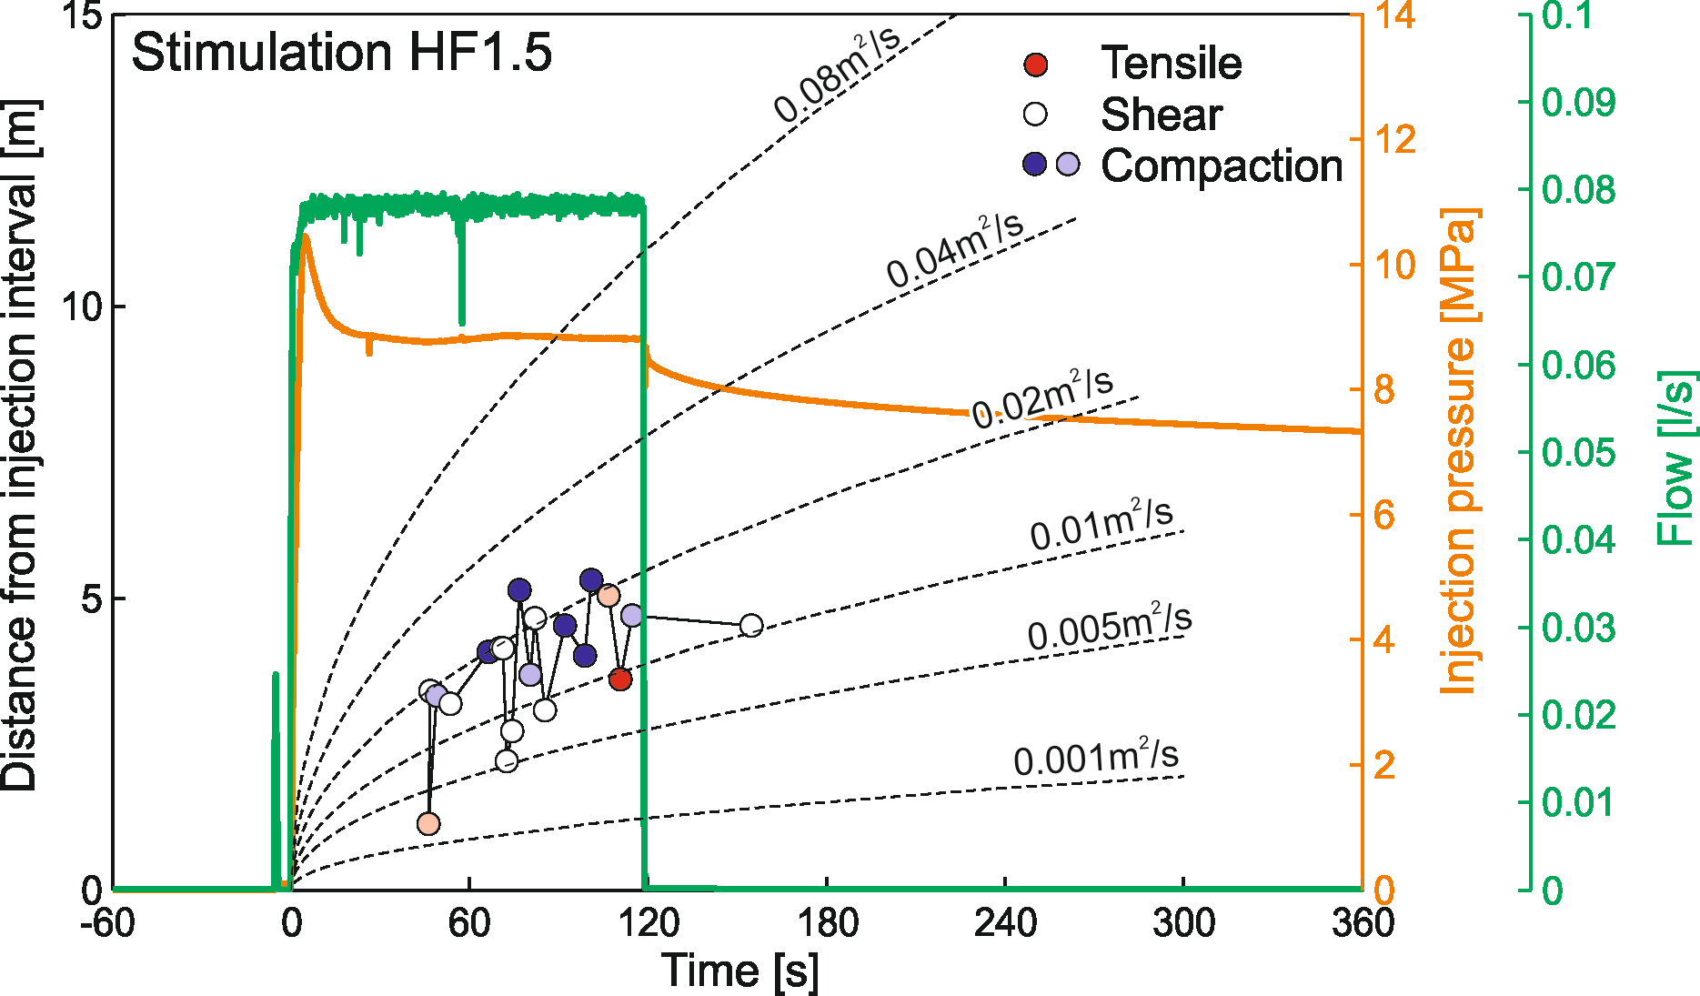
Spatio-temporal behavior
Upward propagation of AEs during injection / retreat of AEs after shut-in
Transition from shearing, crack opening, compaction (injection) to crack closing and shearing (after shut-in)
HF1
Kwiatek et al., JGR, (in prep)
Notes:
Regarding the spatiotemporal behavior, here I show an example from stage 5 of fracture 2 which consists of 50 AEs by ploting the dependence between the time and distance from injection point.
The migration of seismic events upwards from the injection point is observed during the stimulation. The migrations stops after the shut in of the well.
We could also investigate the mechanism of AE events by means of so-called polarity coefficient. This allowed us to split earthquakes into three classes – tensile, shear, and compaction events.
We found out that the injection stage is characterized by whole variety of mechanisms including fault compaction, shearing and, what is important, tensile opening. However, the shut-in phases result in events displaying pore space closing mechanism.

Slide 15
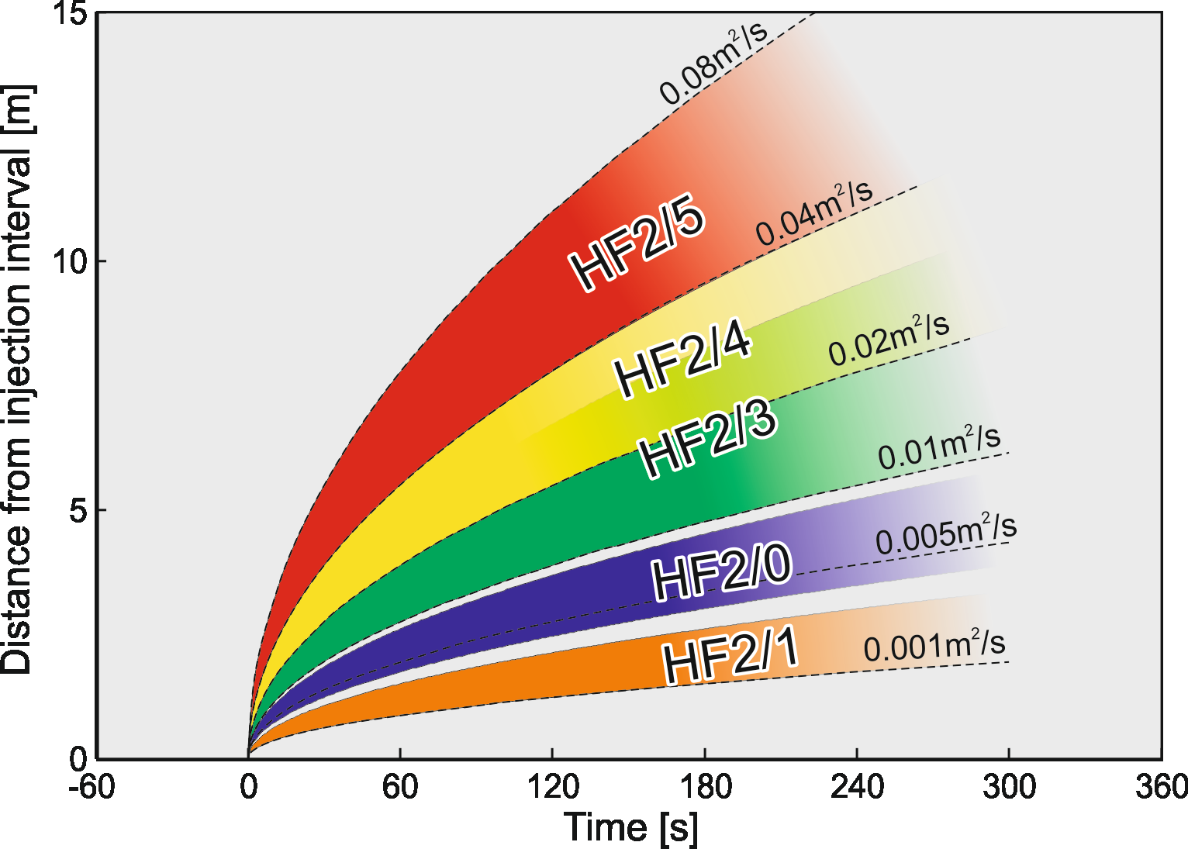
Apparent hydraulic diffusivity changes
Subsequent stimulations lead to faster propagating seismicity reaching larger distances increase of damage and permeability
Increased apparent hydraulic diffusivity for HF2 from 0.005m²/s 0.08m²/s
HF2
continuous
Notes:
Although the seismic data is quite limited, for the second continuous stimulation we observe that for each subsequent stimulation the AE activity propagates faster away from injection point and reaches larger distances. This would suggested the increase of damage and permeability of the fracture network.

Slide 16
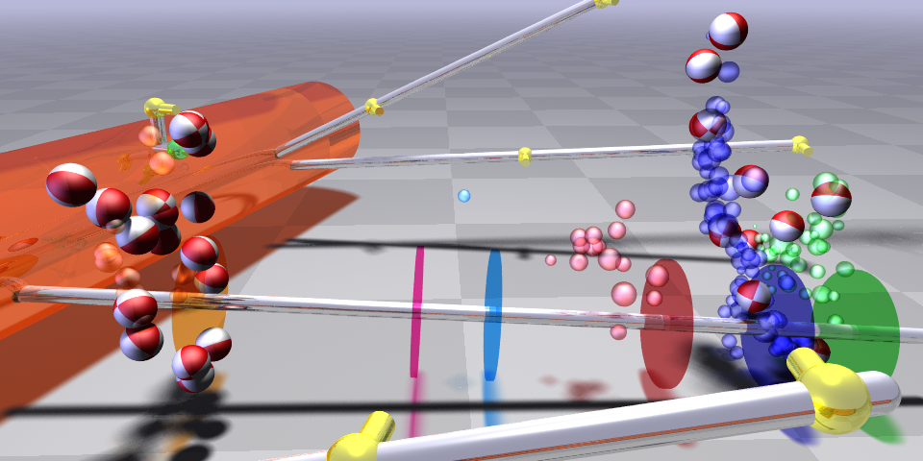
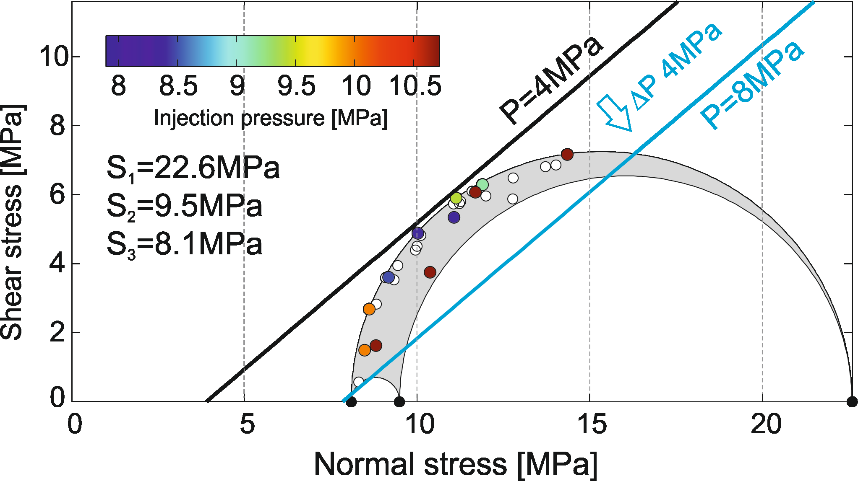
AE mechanisms and injection/pressure changes
Limited focal mechanism data
hybridMT software package
Kwiatek et al. (SRL, 2016)
Complexity of faulting
Fault planes mostly critically stressed
EQs with less optimally oriented planes at higher injection pressures
 Martínez-Garzón et al. (JGR, 2016)
HF6
continuous
HF2
continuous
Stress tensor from overcoring 
(Ask, IJRMMS, 2006)
S₁
312°/3°
22.6MPa
S₂
43°/9°
9.5MPa
S₃
200°/80°
8.1MPa
Kwiatek et al., JGR, (in prep)
Notes:
We used hybridMT algorithm to calculate and then optimize seismic moment tensors. The focal mechanism data is limited due to the low signal to noise ratio. The results indicate at first glimpse an apparent visual fault plane heterogeneity. Nevertheless, if we project the fault planes on the mohr circle, we find out that the resolved fault planes tend to accumulate on the left side of the Mohr circle, close to the failure envelope, suggesting the faults are mostly critically stressed.
Interestingly, the earthquakes with less optimally oriented fault planes occurred at high injection pressures suggesting the influence of pore fluid pressure on orientations of activated fractures.

Slide 17
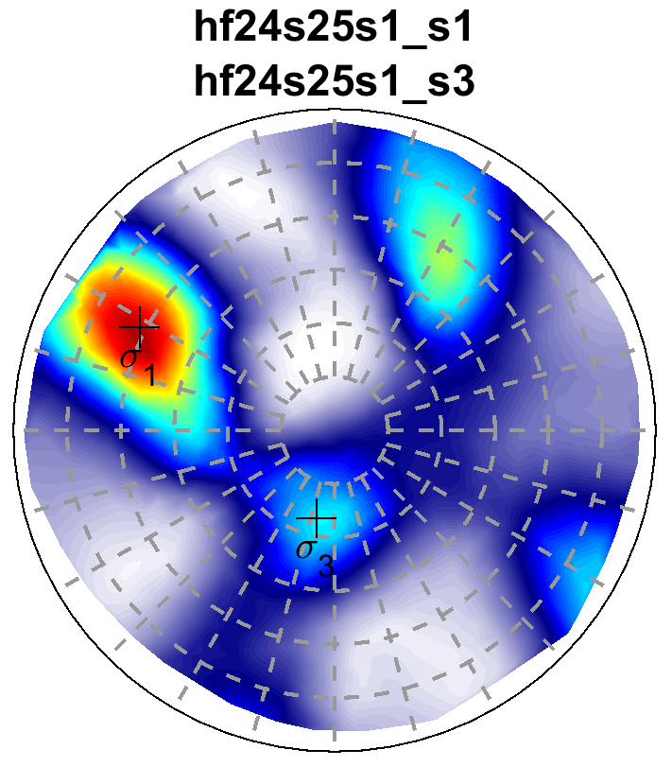
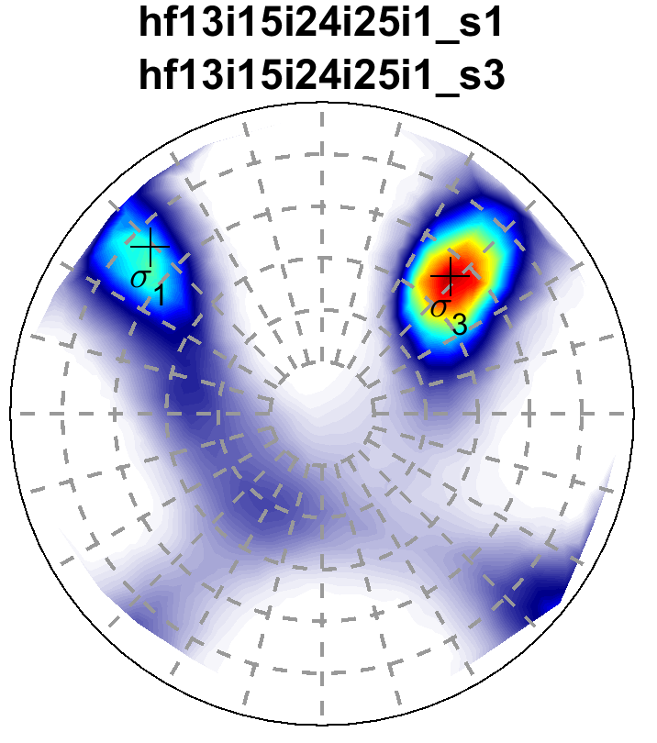
Stress tensor vs injection
Using aggregated polarity data from similar refracs and stress inversion from P-wave polarities
Post-injection AE data reproduce stress tensor orientation from overcoring
Different stress tensor for injection period
 Martínez-Garzón et al. (GRL, 2013)
 Ziegler et al. (GRL, submitted)
HF2
continuous
HF2
continuous
Post-injection
HF2/4+HF2/5
Overcoring
(Ask, IJRMMS, 2006)
Injection
HF1/3+HF1/5+HF2/4+HF2/5
+ σ₂
S₁
312°/3°
+ σ₁
+ σ₃
+ σ₁
S₂
43°/9°
+ σ₃
S₃
200°/80°
+ σ₂
Notes:
A logical consequence of previous observations was to to test whether the injection influences also the stress field orientation.
Due to the data scarcity we aggregate first P-wave polarity data from similar stimulations and performed the nonlinear stress tensor inversion using MOTSI software, separately for AE data from injection periods and AEs occurring after the shut ins.
The inverted data from post-injection phases , despite of expected uncertainties, reproduce quite well the stress field derived from overcoring measurements.
The injection phases lead to stress field that is being rotated with respect to the ambient conditions. The principa stress axis remains same, but the two remaining axes switched orientations, which reflects the uncertainies in resolving stress in conditions where S2 and S3 have similar magnitudes.

Slide 18
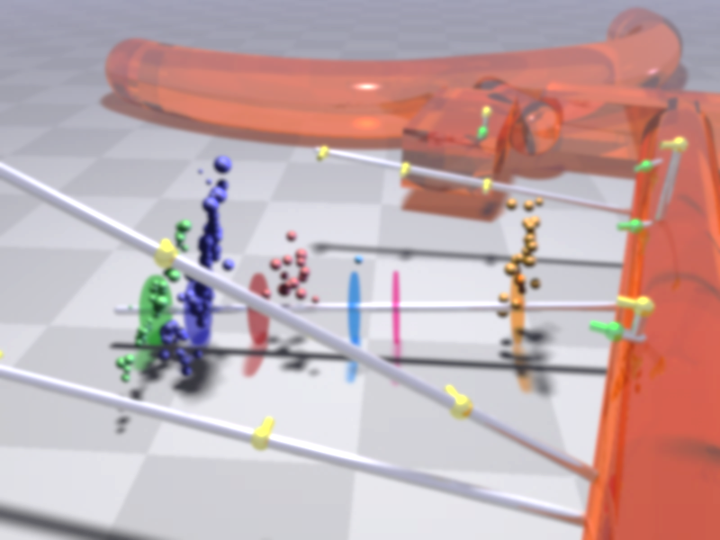
Summary and conclusions
Successful tracking of microfractures evolution of M_{W}-4.2 to -3.5 (cm-dm) size observed with AE acqusition system.
Seismic activity occurs during stimulations and shortly after. The seismic energy release is extremely low with respect to the injected volume.
Correlation of hydraulic energy (rate!) with seismic energy release and maximum magnitude.
Spatial and temporal evolution of AE activity signify increased rock damage and permeability enhancement.
Shear-type mechanisms abundant. AE mechanisms respond to injection operations with fracture opening observed predominantly during stimulation and compaction occurring after shut-in.
The fault planes are heterogeneous, but display favorable orientations with respect to the stress field. Less favorable oriented planes are observed at higher injection pressures.
Notes:
To summarize,

Slide 19
Thank you for your attention!
Contact: kwiatek@gfz-potsdam.de
Kwiatek, G., Martínez-Garzón, P., Plenkers, K., Leonhardt, M., Zang, A., Specht, S., Dresen, G., and M. Bohnhoff. Insights into complex sub-decimeter fracturing processes occurring during water-injection experiment at depth in Äspö Hard Rock Laboratory, Sweden. (in prep)
Notes:
To summarize,

